Slide 1


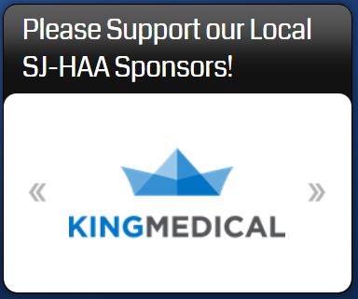

SJ-H
A
St. John-Holy Angels Athletics
Corporate Sponsorship Opportunities
St. John-Holy Angels Athletics (SJ-HAA) is the athletics program for the Parish of St. John-Holy Angels in Newark, Delaware. Serving over 300 student athletes annually, we field teams in 10 individual sports throughout the course of the academic year. SJ-HAA regularly hosts families from over 20 Catholic Parishes in Greater New Castle and Cecil Counties at our athletic facilities in Newark.
SJ-HAA Corporate Sponsorship: $350/year (renewable annually)
Sponsorship includes:
4’ x 3’ banner with your logo and/or any desired text, prominently displayed on the wall of our gymnasium
  Exposure to thousands of potential customers during the course of our Fall and Winter Athletic Seasons
Logo and Link in our Sponsors section of the SJ-HAA website
  Regularly visited by the families of 300 student-athletes to process registration, check scores, program news, etc.
For more information, or to initiate a sponsorship, please contact Laurie Gremminger (Athletics@holyangels.net)
Example 3’ x 4’ banner hung in SJ-HAA Gym
Example logo/link on Website

